Slide 1

Learning jQuery Chapter 3: Handling Events

Slide 2
Introduction
JavaScript has several built-in ways of reacting to user interaction and other events. To make a page dynamic and responsive, we need to harness this capability so that we can, at the appropriate times, use the jQuery techniques we have learned so far and the other tricks we'll learn later. While we could do this with vanilla JavaScript, jQuery enhances and extends the basic event-handling mechanisms to give them a more elegant syntax while making them more powerful at the same time.
In this chapter, we will cover:
Executing JavaScript code when the page is ready
Handling user events, such as mouse clicks and keystrokes
The flow of events through the document, and how to manipulate that flow
Simulating events as if the user initiated them

Slide 3
Performing tasks on page load
We have already seen how to make jQuery react to the loading of a web page. The
$(document).ready() event handler can be used to fire off a function's worth of
code, but there's a bit more to be said about it.

Slide 4
Timing of code execution
In Chapter 1, Getting Started, we noted that $(document).ready() was jQuery’s primary way to perform tasks on page load. It is not, however, the only method at our disposal. The native window.onload event can achieve a similar effect. While the two methods are similar, it is important to recognize their difference in timing, even though it can be quite subtle depending on the number of resources being loaded.
The window.onload event fires when a document is completely downloaded to the browser. This means that every element on the page is ready to be manipulated by JavaScript, which is a boon for writing feature-rich code without worrying about load order.
On the other hand, a handler registered using $(document).ready() is invoked when the DOM is completely ready for use. This also means that all elements are accessible by our scripts, but does not mean that every associated file has been downloaded. As soon as the HTML file has been downloaded and parsed into a DOM tree, the code can run.

Slide 5
Timing of code execution
Consider, for example, a page that presents an image gallery; such a page may have many large images on it, which we can hide, show, move, and otherwise manipulate with jQuery. If we set up our interface using the onload event, users will have to wait until each and every image is completely downloaded before they can use those features. Even worse, if behaviors are not yet attached to elements that have default behaviors (such as links), user interactions could produce unintended outcomes.
However, when we use $(document).ready() for the setup, the interface is ready to be used earlier with the correct behavior.

Slide 6
Handling multiple scripts on one page
The traditional mechanism for registering event handlers through JavaScript (rather than adding handler attributes right in the HTML content) is to assign a function to the DOM element's corresponding property. For example, suppose we had defined the following function:
function doStuff() {
// Perform a task...
}
We could then either assign it within our HTML markup:
<body onload="doStuff();">
Or, we could assign it from within JavaScript code:
window.onload = doStuff;
Both of these approaches will cause the function to execute when the page is loaded. The advantage of the second is that the behavior is cleanly separated from the markup.

Slide 7
Handling multiple scripts on one page
With one function, this strategy works quite well. However, suppose we have a second function as follows:
function doOtherStuff() {
// Perform another task...
}
We could then attempt to assign this function to run on page load:
window.onload = doOtherStuff;
However, this assignment trumps the first one. The .onload attribute can only store one function reference at a time, so we can't add to the existing behavior.
The $(document).ready() mechanism handles this situation gracefully. Each call to the method adds the new function to an internal queue of behaviors; when the page is loaded, all of the functions will execute. The functions will run in the order in which they were registered.

Slide 8
Alternate syntax for .ready()
The $(document).ready() construct is actually calling the .ready() method on a jQuery object we've constructed from the document DOM element. The $() function provides a shortcut for us as this is a common task. When we pass in a function as the argument to $(), jQuery performs an implicit call to .ready(). We normally write this construct in the following way:
$(document).ready(function() {
// Our code here...
});
However, we can choose to use the following shorter version instead:
$(function() {
// Our code here...
});
While the latter syntax is shorter, the longer version makes code more descriptive about what it is doing. For this reason, we will use the longer syntax throughout this book.

Slide 9
Passing an argument to the .ready() callback
In some cases, it may prove useful to use more than one JavaScript library on the same page. Since many libraries make use of the $ identifier (since it is short and convenient), we need a way to prevent collisions between these uses.
Fortunately, jQuery provides a method called jQuery.noConflict() to return control of the $ identifier back to other libraries. Typical usage of jQuery.noConflict() follows the following pattern:
<script src="prototype.js"></script>
<script src="jquery.js"></script>
<script>
jQuery.noConflict();
</script>
<script src="myscript.js"></script>

Slide 10
Passing an argument to the .ready() callback
First, the other library (Prototype in this example) is included. Then, jQuery itself is included, taking over $ for its own use. Next, a call to .noConflict() frees up $, so that control of it reverts to the first included library (Prototype). Now in our custom script we can use both libraries—but whenever we want to use a jQuery method, we need to write jQuery instead of $ as an identifier.
The .ready() method has one more trick up its sleeve to help us in this situation. The callback function we pass to it can take a single parameter—the jQuery object itself. This allows us to effectively rename it without fear of conflicts using the following syntax:
jQuery(document).ready(function($) {
// In here, we can use $ like normal!
});
Or we can use the shorter syntax we learned previously:
jQuery(function($) {
// Code that uses $.
});

Slide 11
Handling simple events
There are many other times apart from the loading of the page at which we might want to perform a task. Just as JavaScript allows us to intercept the page load event with <body onload=""> or window.onload, it provides similar hooks for user-initiated events such as mouse clicks (onclick), form fields being modified (onchange), and windows changing size (onresize). When assigned directly to elements in the DOM, these hooks have similar drawbacks to the ones we outlined for onload. Therefore, jQuery offers an improved way of handling these events as well.

Slide 12
A simple style switcher
To illustrate some event handling techniques, suppose we wish to have a single page rendered in several different styles based on user input. We will present buttons that allow the user to toggle between a normal view, a view in which the text is constrained to a narrow column, and a view with large print for the content area.
The HTML markup for the style switcher is as follows:
<div id="switcher" class="switcher">
<h3>Style Switcher</h3>
<button id="switcher-default">Default</button>
<button id="switcher-narrow">Narrow Column</button>
<button id="switcher-large">Large Print</button>
</div>

Slide 13
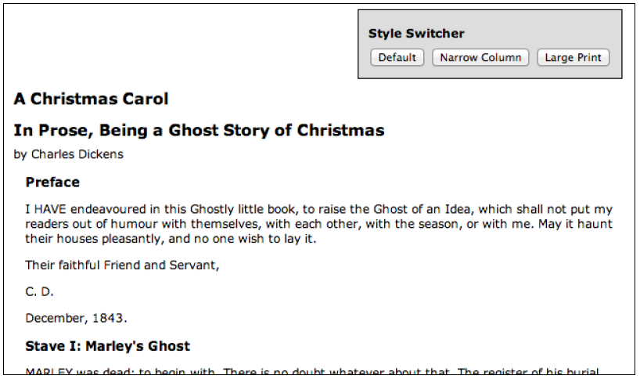
A simple style switcher
Combined with the rest of the page's HTML markup and some basic CSS, we get a page that looks like the following:

Slide 14
A simple style switcher
To begin with, we'll make the Large Print button operate. We need a bit of CSS to implement our alternative view of the page as follows:
body.large .chapter {
font-size: 1.5em;
}
Our goal, then, is to apply the large class to the <body> tag. This will allow the stylesheet to reformat the page appropriately. Using what we learned in Chapter 2, Selecting Elements, we already know the statement needed to accomplish this:
$('body').addClass('large');

Slide 15
A simple style switcher
However, we want this to occur when the button is clicked, not when the page is loaded as we have seen so far. To do this, we'll introduce the .on() method. This method allows us to specify any DOM event and to attach a behavior to it. In this case, the event is called click, and the behavior is a function consisting of our previous one-liner:
$(document).ready(function() {
$('#switcher-large').on('click', function() {
$('body').addClass('large');
});
});
Listing 3.1

Slide 16
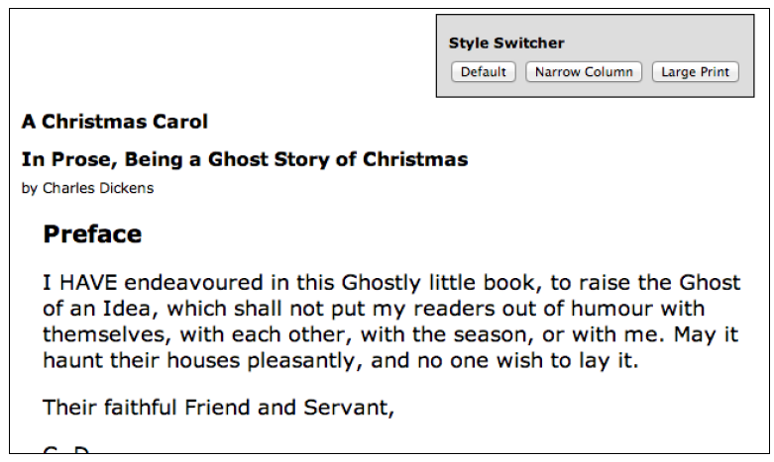
A simple style switcher
Now when the button gets clicked on, our code runs and the text is enlarged:
That's all there is to binding a behavior to an event. The advantages we discussed with the .ready() method apply here as well. Multiple calls to .on() coexist nicely, appending additional behaviors to the same event as necessary.
This is not necessarily the most elegant or efficient way to accomplish this task. As we proceed through this chapter, we will extend and refine this code into something we can be proud of.

Slide 17
Enabling the other buttons
We now have a Large Print button that works as advertised, but we need to apply similar handling to the other two buttons (Default and Narrow Column) to make them perform their tasks. This is straightforward; we use .on() to add a click handler to each of them, removing and adding classes as necessary. The new code reads as follows:
$(document).ready(function() {
$('#switcher-default').on('click', function() {
$('body').removeClass('narrow');
$('body').removeClass('large');
});
$('#switcher-narrow').on('click', function() {
$('body').addClass('narrow');
$('body').removeClass('large');
});
$('#switcher-large').on('click', function() {
$('body').removeClass('narrow');
$('body').addClass('large');
});
});
Listing 3.2

Slide 18
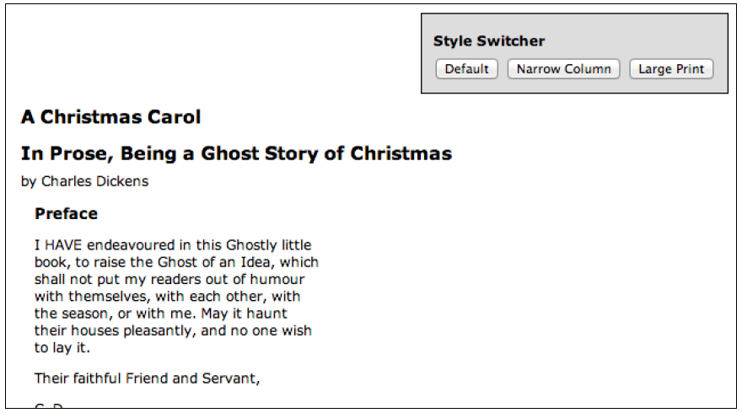
Enabling the other buttons
This is combined with a CSS rule for the narrow class:
body.narrow .chapter {
width: 250px;
}
Now, after clicking the Narrow Column button, its corresponding CSS is applied and the text gets laid out differently:
Clicking on Default removes both class names from the <body> tag, returning the page to its initial rendering.

Slide 19
Making use of the event handler context
Our switcher is behaving correctly, but we are not giving the user any feedback about which button is currently active. Our approach for handling this will be to apply the selected class to the button when it is clicked, and to remove this class from the other buttons. The selected class simply makes the button's text bold:
.selected {
font-weight: bold;
}
We could accomplish this class modification as we did previously by referring to each button by ID and applying or removing classes as necessary, but instead we’ll explore a more elegant and scalable solution that exploits the context in which event handlers run.
When any event handler is triggered, the keyword this refers to the DOM element to which the behavior was attached. Earlier we noted that the $() function could take a DOM element as its argument; this is one of the key reasons why that facility is available. By writing $(this) within the event handler, we create a jQuery object corresponding to the element, and we can act on it just as if we had located it with a CSS selector.

Slide 20
Making use of the event handler context
With this in mind, we can write the following:
$(this).addClass('selected');
Placing this line in each of the three handlers will add the class when a button is clicked. To remove the class from the other buttons, we can take advantage of jQuery's implicit iteration feature, and write:
$('#switcher button’) .removeClass('selected');
This line removes the class from every button inside the style switcher. We should also add the class to the Default button when the document is ready. So, placing these in the correct order, code is as follows:
$(document).ready(function() {
$('#switcher-default').addClass('selected').on('click', function() {
$('body').removeClass('narrow');
$('body').removeClass('large');
$('#switcher button').removeClass('selected’);
$(this).addClass('selected'); });
$('#switcher-narrow').on('click', function() {
$('body').addClass('narrow');
$('body').removeClass('large');
$('#switcher button').removeClass('selected');
$(this).addClass('selected’); });
$('#switcher-large').on('click', function() {
$('body').removeClass('narrow');
$('body').addClass('large');
$('#switcher button').removeClass('selected');
$(this).addClass('selected’); });
});
Listing 3.3

Slide 21
Making use of the event handler context
Now the style switcher gives appropriate feedback.
Generalizing the statements by using the handler context allows us to be yet more efficient. We can factor the highlighting routine out into a separate handler, as shown in Listing 3.4, because it is the same for all three buttons:
$(document).ready(function() {
$('#switcher-default').addClass('selected').on('click', function(){
$('body').removeClass('narrow').removeClass('large');
});
$('#switcher-narrow').on('click', function() {
$('body').addClass('narrow').removeClass('large');
});
$('#switcher-large').on('click', function() {
$('body').removeClass('narrow').addClass('large');
});
$('#switcher button').on('click', function() {
$('#switcher button').removeClass('selected');
$(this).addClass('selected');
});
});
Listing 3.4

Slide 22
Making use of the event handler context
This optimization takes advantage of three jQuery features we have already discussed. First, implicit iteration is once again useful when we bind the same click handler to each button with a single call to .on(). Second, behavior queuing allows us to bind two functions to the same click event without the second overwriting the first. Lastly, we're using jQuery's chaining capabilities to collapse the adding and removing of classes into a single line of code each time.

Slide 23
Consolidating code using the event context
The code optimization we've just completed is an example of refactoring—modifying existing code to perform the same task in a more efficient or elegant way. To explore further refactoring opportunities, let's look at the behaviors we have bound to each button. The .removeClass() method's parameter is optional; when omitted, it removes all classes from the element. We can streamline our code a bit by exploiting this as follows:
Note that the order of operations has changed a bit to accommodate our more general class removal; we need to execute .removeClass() first so that it doesn’t undo the call to .addClass(), which we perform in the same breath.
// work in progress
$(document).ready(function() {
$('#switcher-default').addClass('selected').on('click', function() {
$('body').removeClass();
});
$('#switcher-narrow').on('click', function() {
$('body').removeClass().addClass('narrow');
});
$('#switcher-large').on('click', function() {
$('body').removeClass().addClass('large');
});
$('#switcher button').on('click', function() {
$('#switcher button').removeClass('selected');
$(this).addClass('selected');
});
});
Listing 3.5

Slide 24
Consolidating code using the event context
Now we are executing some of the same code in each of the buttons' handlers. This can be easily factored out into our general button click handler:
Note that we need to move the general handler above the specific ones now. The .removeClass() call needs to happen before .addClass() executes, and we can count on this because jQuery always triggers event handlers in the order in which they were registered.
$(document).ready(function() {
$('#switcher-default').addClass('selected');
$('#switcher button').on('click', function() {
$('body').removeClass();
$('#switcher button').removeClass('selected');
$(this).addClass('selected');
});
$('#switcher-narrow').on('click', function() {
$('body').addClass('narrow');
});
$('#switcher-large').on('click', function() {
$('body').addClass('large');
});
});
Listing 3.6

Slide 25
Consolidating code using the event context
Finally, we can get rid of the specific handlers entirely by once again exploiting event context. Since the context keyword this gives us a DOM element rather than a jQuery object, we can use native DOM properties to determine the ID of the element that was clicked. We can thus bind the same handler to all the buttons, and within the handler perform different actions for each button:
The value of the bodyClass variable will be default, narrow, or large, depending on which button is clicked. Here, we are departing somewhat from our previous code; in that we are adding a default class to <body> when the user clicks on <button id="switcher-default">. While we do not need this class applied, it isn’t causing any harm either, and the reduction of code complexity more than makes up for an unused class name.
$(document).ready(function() {
$('#switcher-default').addClass('selected');
$('#switcher button').on('click', function() {
var bodyClass = this.id.split('-')[1];
$('body').removeClass().addClass(bodyClass);
$('#switcher button').removeClass('selected');
$(this).addClass('selected');
});
});
Listing 3.7

Slide 26
Shorthand events
Binding a handler for an event (such as a simple click event) is such a common task that jQuery provides an even terser way to accomplish it; shorthand event methods work in the same way as their .on() counterparts with a couple fewer keystrokes. For example, our style switcher could be written using .click() instead of .on()as follows:
Shorthand event methods such as the previous one exist for the other standard DOM events such as blur, keydown, and scroll as well. Each shortcut method binds a handler to the event with the corresponding name.
$(document).ready(function() {
$('#switcher-default').addClass('selected');
$('#switcher button').click(function() {
var bodyClass = this.id.split('-')[1];
$('body').removeClass().addClass(bodyClass);
$('#switcher button').removeClass('selected');
$(this).addClass('selected');
});
});
Listing 3.8

Slide 27
Showing and hiding advanced features
Suppose that we wanted to be able to hide our style switcher when it is not needed. One convenient way to hide advanced features is to make them collapsible. We will allow one click on the label to hide the buttons, leaving the label alone. Another click on the label will restore the buttons. We need another class as follows to handle the hidden buttons:
.hidden {
display: none;
}
We could implement this feature by storing the current state of the buttons in a variable and checking its value each time the label is clicked to know whether to add or remove the hidden class on the buttons. However, jQuery provides an easy way for us to add or remove a class depending on whether that class is already present—the .toggleClass() method.
$(document).ready(function() {
$('#switcher h3').click(function() {
$('#switcher button').toggleClass('hidden');
});
});
Listing 3.9

Slide 28
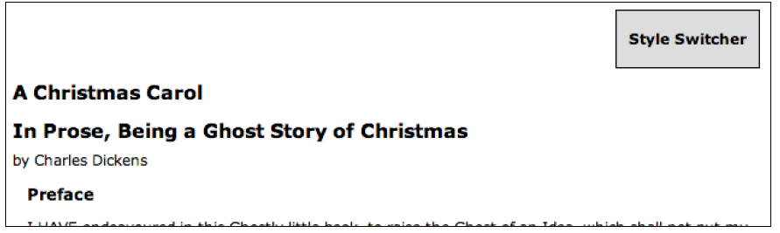
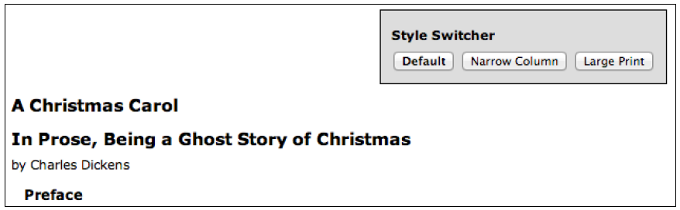
Showing and hiding advanced features
After the first click, the buttons are all hidden:
And a second click returns them to visibility:
Once again, we rely on implicit iteration, this time to hide all the buttons in one fell swoop without requiring an enclosing element.

Slide 29
Event propagation
In illustrating the ability of the click event to operate on normally non-clickable page elements, we have crafted an interface that gives few hints that the style switcher label—actually just an <h3> element—is actually a live part of the page awaiting user interaction. To remedy this, we can give it a rollover state, making it clear that it interacts in some way with the mouse:
.hover {
cursor: pointer;
background-color: #afa;
}
The CSS specification includes a pseudo-class called :hover, which allows a stylesheet to affect an element's appearance when the user's mouse cursor hovers over it. This would certainly solve our problem in this instance, but instead, we will take this opportunity to introduce jQuery's .hover() method, which allows us to use JavaScript to change an element's styling—and indeed, perform any arbitrary action—both when the mouse cursor enters the element and when it leaves the element.

Slide 30
Event propagation
The .hover() method takes two function arguments, unlike the simple event methods we have so far encountered. The first function will be executed when the mouse cursor enters the selected element, and the second is fired when the cursor leaves. We can modify the classes applied to the buttons at these times to achieve a rollover effect:
$(document).ready(function() {
$('#switcher h3').hover(function() {
$(this).addClass('hover');
}, function() {
$(this).removeClass('hover');
});
});
Listing 3.10

Slide 31
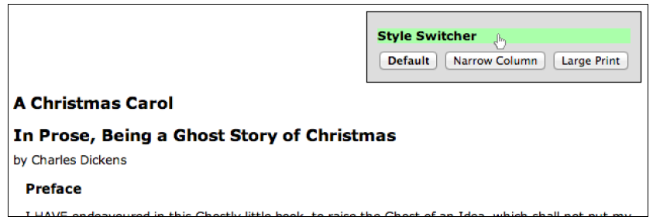
Event propagation
We once again use implicit iteration and event context for short and simple code. Now when hovering over the <h3> element, we see our class applied:
The use of .hover() also means we avoid headaches caused by event propagation in JavaScript. To understand this, we need to take a look at how JavaScript decides which element gets to handle a given event.

Slide 32
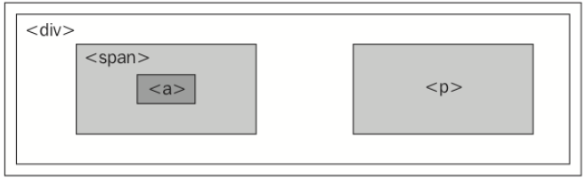
The journey of an event
When an event occurs on a page, an entire hierarchy of DOM elements gets a chance to handle the event. Consider a page model like the following:
<div class="foo">
<span class="bar">
<a href="http://www.example.com/">The quick brown fox jumps over the lazy dog.</a>
</span>
<p>How razorback-jumping frogs can level six piqued gymnasts!</p>
</div>
We then visualize the code as a set of nested elements:

Slide 33
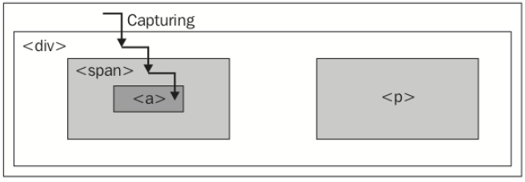
The journey of an event
For any event, there are multiple elements that could logically be responsible for reacting. When the link on this page is clicked, for example, the <div>, <span>, and <a> elements should all get the opportunity to respond to the click. After all, these three elements are all under the user's mouse cursor at the time. The <p> element, on the other hand, is not part of this interaction at all.
One strategy for allowing multiple elements to respond to a user interaction is called event capturing. With event capturing, the event is first given to the most allencompassing element, and then to progressively more specific ones. In our example, this means that first the <div> element gets passed the event, then the <span> element, and finally the <a> element, as shown in the following figure:

Slide 34
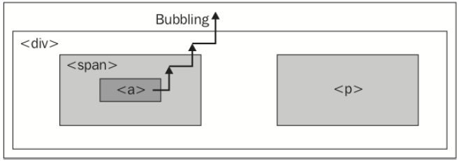
The journey of an event
The opposite strategy is called event bubbling. The event gets sent to the most specific element, and after this element has an opportunity to react, the event bubbles up to more general elements. In our example, the <a> element would be handed the event first, and then the <span> and <div> elements in that order, as shown in the following figure:

Slide 35
The journey of an event
Unsurprisingly, different browser developers originally decided on different models for event propagation. The DOM standard that was eventually developed thus specified that both strategies should be used: first the event is captured from general elements to specific ones, and then the event bubbles back up to the top of the DOM tree. Event handlers can be registered for either part of the process.
To provide consistent and easy-to-understand behavior, jQuery always registers event handlers for the bubbling phase of the model. We can always assume that the most specific element will get the first opportunity to respond to any event.

Slide 36
Side effects of event bubbling
Event bubbling can cause unexpected behavior, especially when the wrong element responds to a mouseover or mouseout event. Consider a mouseout event handler attached to the <div> element in our example. When the user's mouse cursor exits the <div> element, the mouseout handler is run as anticipated. Since this is at the top of the hierarchy, no other elements get the event. On the other hand, when the cursor exits the <a> element, a mouseout event is sent to that. This event will then bubble up to the <span> element and then to the <div> element, firing the same event handler. This bubbling sequence is likely not desired.
The mouseenter and mouseleave events, either bound individually or combined in the .hover() method, are aware of these bubbling issues, and when we use them to attach events, we can ignore the problems caused by the wrong element getting a mouseover or mouseout event.
The mouseout scenario just described illustrates the need to constrain the scope of an event. While .hover() handles this specific case, we will encounter other situations in which we need to limit an event spatially (preventing the event from being sent to certain elements) or temporally (preventing the event from being sent at certain times).

Slide 37
Altering the journey – the event object
We have already seen one situation in which event bubbling can cause problems. To show a case in which .hover() does not help our cause, we'll alter the collapsing behavior that we implemented earlier.
Suppose we wish to expand the clickable area that triggers the collapsing or expanding of the style switcher. One way to do this is to move the event handler from the label, <h3>, to its containing <div> element. In Listing 3.9, we added a click handler to #switcher h3; we will attempt this change by attaching the handler to #switcher instead:
// Unfinished code
$(document).ready(function() {
$('#switcher').click(function() {
$('#switcher button').toggleClass('hidden');
});
});
Listing 3.11

Slide 38
Altering the journey – the event object
This alteration makes the entire area of the style switcher clickable to toggle its visibility. The downside is that clicking on a button also collapses the style switcher after the style on the content has been altered. This is due to event bubbling; the event is first handled by the buttons, then passed up through the DOM tree until it reaches the <div id="switcher"> element, where our new handler is activated and hides the buttons.
To solve this problem, we need access to the event object. This is a DOM construct that is passed to each element's event handler when it is invoked. It provides information about the event, such as where the mouse cursor was at the time of the event. It also provides some methods that can be used to affect the progress of the event through the DOM.

Slide 39
Altering the journey – the event object
To use the event object in our handlers, we only need to add a parameter to the function:
$(document).ready(function() {
$('#switcher').click(function(event) {
$('#switcher button').toggleClass('hidden');
});
});
Note that we have named this parameter event because it is descriptive, not because we need to. Naming it flapjacks or anything else for that matter would work just as well.

Slide 40
Altering the journey – the event object
Now we have the event object available to us as the variable event within our handler. The property event.target can be helpful in controlling where an event takes effect. This property is a part of the DOM API, but is not implemented in some older browser versions; jQuery extends the event object as necessary to provide the property in every browser. With .target, we can determine which element in the DOM was the first to receive the event. In the case of a click event, this will be the actual item clicked on. Remembering that this gives us the DOM element handling the event, we can write the following code:
// Unfinished code
$(document).ready(function() {
$('#switcher').click(function(event) {
if (event.target == this) {
$('#switcher button').toggleClass('hidden');
}
});
});
Listing 3.12

Slide 41
Altering the journey – the event object
This code ensures that the item clicked on was <div id="switcher">, not one of its sub-elements. Now, clicking on buttons will not collapse the style switcher, but clicking on the switcher's background will. However, clicking on the label, <h3>, now does nothing, because it too is a sub-element. Instead of placing this check here, we can modify the behavior of the buttons to achieve our goals.

Slide 42
Stopping event propagation
The event object provides the .stopPropagation() method, which can halt the bubbling process completely for the event. Like .target, this method is a basic DOM feature, but cannot be safely used as such in Internet Explorer 8 or older.
As long as we register all of our event handlers using jQuery, though, we can use it with impunity.
We'll remove the event.target == this check we just added, and instead add some code in our buttons' click handlers:
$(document).ready(function() {
$('#switcher').click(function(event) {
$('#switcher button').toggleClass('hidden');
});
});
$(document).ready(function() {
$('#switcher-default').addClass('selected’);
$('#switcher button').click(function(event) {
var bodyClass = this.id.split('-')[1];
$('body').removeClass().addClass(bodyClass);
$('#switcher button').removeClass('selected');
$(this).addClass('selected');
event.stopPropagation();
});
});
Listing 3.13

Slide 43
Stopping event propagation
As before, we need to add a parameter to the function we're using as the click handler so we have access to the event object. Then, we simply call event.stopPropagation() to prevent any other DOM element from responding to the event. Now our click is handled by the buttons, and only the buttons; clicks anywhere else on the style switcher will collapse or expand it.

Slide 44
Preventing default actions
If our click event handler was registered on a link element (<a>) rather than a generic <button> element outside of a form, we would face another problem. When a user clicks on a link, the browser loads a new page. This behavior is not an event handler in the same sense as the ones we have been discussing; instead, this is the default action for a click on a link element. Similarly, when the Enter key is pressed while the user is editing a form, the submit event may be triggered on the form, but then the form submission actually occurs after this.
If these default actions are undesired, calling .stopPropagation() on the event will not help. These actions occur nowhere in the normal flow of event propagation. Instead, the .preventDefault() method will serve to stop the event in its tracks before the default action is triggered.
Event propagation and default actions are independent mechanisms; either of them can be stopped while the other still occurs. If we wish to halt both, we can return false at the end of our event handler, which is a shortcut for calling both .stopPropagation() and .preventDefault() on the event.

Slide 45
Delegating events
Event bubbling isn't always a hindrance; we can often use it to great benefit. One great technique that exploits bubbling is called event delegation. With it, we can use an event handler on a single element to do the work of many.
In our example, there are just three <button> elements that have attached click handlers. But what if there were many? This is more common than you might think. Consider, for example, a large table of information in which each row has an interactive item requiring a click handler. Implicit iteration makes assigning all of these click handlers easy, but performance can suffer because of the looping being done internally to jQuery, and because of the memory footprint of maintaining all the handlers.
Instead, we can assign a single click handlera to an ancestor element in the DOM. An uninterrupted click event will eventually reach the ancestor due to event bubbling, and we can do our work there.

Slide 46
Delegating events
As an example, let's apply this technique to our style switcher (even though the number of items does not demand the approach). As seen in Listing 3.12 previously, we can use the event.target property to check what element is under the mouse cursor when the click event occurs.
$(document).ready(function() {
$('#switcher').click(function(event) {
if ($(event.target).is('button')) {
var bodyClass = event.target.id.split('-')[1];
$('body').removeClass().addClass(bodyClass);
$('#switcher button').removeClass('selected');
$(event.target).addClass('selected');
event.stopPropagation();
}
});
});
Listing 3.14

Slide 47
Delegating events
We've used a new method here called .is(). This method accepts the selector expressions we investigated in the previous chapter and tests the current jQuery object against the selector. If at least one element in the set is matched by the selector, .is()returns true. In this case, $(event.target).is('button') asks whether the element clicked is a <button> element. If so, we proceed with the previous code, with one significant alteration: the keyword this now refers to <div id="switcher">, so every time we are interested in the clicked button, we must now refer to it with event.target.

Slide 48
Delegating events
$(document).ready(function() {
$('#switcher').hover(function() {
$(this).addClass('hover');
}, function() {
$(this).removeClass('hover');
});
});
$(document).ready(function() {
$('#switcher').click(function(event) {
if (!$(event.target).is('button')) {
$('#switcher button').toggleClass('hidden');
}
});
});
$(document).ready(function() {
$('#switcher-default').addClass('selected');
$('#switcher').click(function(event) {
if ($(event.target).is('button')) {
var bodyClass = event.target.id.split('-')[1];
$('body').removeClass().addClass(bodyClass);
$('#switcher button').removeClass('selected');
$(event.target).addClass('selected');
}
});
});
Listing 3.15

Slide 49
Delegating events
This example is a bit overcomplicated for its size, but as the number of elements with event handlers increases, so does event delegation's benefit. Also, we can avoid some of the code repetition by combining the two click handlers and using a single if-else statement for the .is() test:
$(document).ready(function() {
$('#switcher-default').addClass('selected');
$('#switcher').click(function(event) {
if ($(event.target).is('button')) {
var bodyClass = event.target.id.split('-')[1];
$('body').removeClass().addClass(bodyClass);
$('#switcher button').removeClass('selected');
$(event.target).addClass('selected');
} else {
$('#switcher button').toggleClass('hidden');
}
});
});
Listing 3.16

Slide 50
Delegating events
While our code could still use some fine tuning, it is approaching a state at which we can feel comfortable using it for what we set out to do. Nevertheless, for the sake of learning more about jQuery's event handling, we'll back up to Listing 3.15 and continue to modify that version of the code.

Slide 51
Delegating events
We have an unintentional side-effect from this code, however. When a button is clicked now, the switcher collapses, as it did before we added the call to .stopPropagation(). The handler for the switcher visibility toggle is now bound to the same element as the handler for the buttons, so halting the event bubbling does not stop the toggle from being triggered. To sidestep this issue, we can remove the .stopPropagation() call and instead add another .is() test. Also, since we’re making the entire switcher <div> element clickable, we ought to toggle the hover class while the user's mouse is over any part of it:
$(document).ready(function() {
$('#switcher').hover(function() {
$(this).addClass('hover');
}, function() {
$(this).removeClass('hover');
});
});
$(document).ready(function() {
$('#switcher').click(function(event) {
if (!$(event.target).is('button')) {
$('#switcher button').toggleClass('hidden');
}
});
});

Slide 52
Using built-in event-delegation capabilities
Because event delegation can be helpful in so many situations, jQuery includes a set of tools to aid developers in using this technique. The .on() method we have already discussed can perform event delegation when provided with appropriate parameters:
$('#switcher').on('click', 'button', function() {
var bodyClass = event.target.id.split('-')[1];
$('body').removeClass().addClass(bodyClass);
$('#switcher button').removeClass('selected');
$(this).addClass('selected');
});
Listing 3.17
When a selector expression is provided as the second argument to .on(), jQuery binds the click handler to the #switcher object, but compares event.target against the selector expression—in this case, 'button'. If it matches, jQuery maps the this keyword to the matched element. Otherwise, the event handler is not executed at all.

Slide 53
Removing an event handler
There are times when we will be done with an event handler we previously registered. Perhaps the state of the page has changed such that the action no longer makes sense. It is typically possible to handle this situation with conditional statements inside our event handlers, but it may be more elegant to unbind the handler entirely. Suppose that we want our collapsible style switcher to remain expanded whenever the page is not using the normal style. While the Narrow Column or Large Print button is selected, clicking on the background of the style switcher should do nothing. We can accomplish this by calling the the .off() method to remove the collapsing handler when one of the non-default style switcher buttons is clicked:
$(document).ready(function() {
$('#switcher').click(function(event) {
if (!$(event.target).is('button')) {
$('#switcher button').toggleClass('hidden');
}
});
$('#switcher-narrow, #switcher-large').click(function() {
$('#switcher').off('click');
});
});
Listing 3.18

Slide 54
Removing an event handler
Now when a button such as Narrow Column is clicked, the click handler on the style switcher <div> is removed, and clicking on the background of the box no longer collapses it. However, the buttons don't work anymore! They are affected by the click event of the style switcher <div> as well, because we rewrote the button-handling code to use event delegation. This means that when we call $('#switcher').off('click'), both behaviors are removed.

Slide 55
Giving namespaces to event handlers
We need to make our .off() call more specific so that it does not remove both of the click handlers we have registered. One way of doing this is to use event namespacing. We can introduce additional information when an event is bound that allows us to identify that particular handler later. To use namespacing, we need to return to the non-shorthand method of binding event handlers, the .on() method itself.
The first parameter we pass to .on() is the name of the event we want to watch for. We can use a special syntax here, though, that allows us to subcategorize the event:
$(document).ready(function() {
$('#switcher').on('click.collapse', function(event) {
if (!$(event.target).is('button')) {
$('#switcher button').toggleClass('hidden');
}
});
$('#switcher-narrow, #switcher-large').click(function() {
$('#switcher').off('click.collapse');
});
});
Listing 3.19

Slide 56
Giving namespaces to event handlers
The .collapse suffix is invisible to the event handling system; click events are handled by this function, just as if we wrote .on('click'). However, the addition of the namespace means that we can unbind just this handler without affecting the separate click handler we wrote for the buttons.

Slide 57
Rebinding events
Now clicking on the Narrow Column or Large Print button causes the style switcher collapsing functionality to be disabled. However, we want the behavior to return when the Default button is pressed. To do this, we will need to rebind the handler whenever Default is clicked.
First, we should give our handler function a name so that we can use it more than once without repeating ourselves:
$(document).ready(function() {
var toggleSwitcher = function(event) {
if (!$(event.target).is('button')) {
$('#switcher button').toggleClass('hidden');
}
};
$('#switcher').on('click.collapse', toggleSwitcher);
});
Listing 3.20

Slide 58
Rebinding events
Note that we are using a new syntax here for defining a function. Rather than use a function declaration (defining the function by leading with the function keyword and naming it), we use an anonymous function expression, assigning a no-name function to a local variable. Aside from a couple of subtle differences that don’t apply in this case, the two syntaxes are functionally equivalent. Here, our use of the function expression is a stylistic choice to make our event handlers and other function definitions resemble each other more closely.
Also, recall that we are passing .on() a function reference as its second argument. It is important to remember when referring to a function that we must omit parentheses after the function name; parentheses would cause the function to be called rather than referenced.

Slide 59
Rebinding events
Now that the function can be referenced, we can bind it again later without repeating the function definition:
// Unfinished code
$(document).ready(function() {
var toggleSwitcher = function(event) {
if (!$(event.target).is('button')) {
$('#switcher button').toggleClass('hidden');
}
};
$('#switcher').on('click.collapse', toggleSwitcher);
$('#switcher-narrow, #switcher-large').click(function() {
$('#switcher').off('click.collapse');
});
$('#switcher-default').click(function() {
$('#switcher').on('click.collapse', toggleSwitcher);
});
});
Listing 3.21

Slide 60
Rebinding events
Now the toggle behavior is bound when the document is loaded, unbound when Narrow Column or Large Print is clicked, and rebound when Normal is clicked after that.
Since we have named the function, we no longer need to use namespacing. The .off() method can take a function as a second argument; in this case, it unbinds only that specific handler. However, we have run into another problem. Remember that when a handler is bound to an event in jQuery, previous handlers remain in effect. In this case, each time Normal is clicked, another copy of the toggleSwitcher handler is bound to the style switcher. In other words, the function is called an extra time for each additional click until the user clicks Narrow or Large Print, which unbinds all of the toggleSwitcher handlers at once.

Slide 61
Rebinding events
When an even number of toggleSwitcher handlers are bound, clicks on the style switcher (but not on a button) appear to have no effect. In fact, the hidden class is being toggled multiple times, ending up in the same state it was when it began. To remedy this problem, we can unbind the handler when a user clicks on any button, and rebind only after ensuring that the clicked button's ID is switcher-default:
$(document).ready(function() {
var toggleSwitcher = function(event) {
if (!$(event.target).is('button')) {
$('#switcher button').toggleClass('hidden');
}
};
$('#switcher').on('click', toggleSwitcher);
$('#switcher button').click(function() {
$('#switcher').off('click', toggleSwitcher);
if (this.id == 'switcher-default') {
$('#switcher').on('click', toggleSwitcher);
}
});
});
Listing 3.22

Slide 62
Rebinding events
A shortcut is also available for the situation in which we want to unbind an event handler immediately after the first time it is triggered. This shortcut, called .one(), is used as follows:
$('#switcher').one('click', toggleSwitcher);
This would cause the toggle action to occur only once.

Slide 63
Simulating user interaction
At times, it is convenient to execute code that we have bound to an event, even if the normal circumstances of the event are not occurring. For example, suppose we wanted our style switcher to begin in its collapsed state. We could accomplish this by hiding buttons from within the stylesheet, or by adding our hidden class or calling the .hide() method from a $(document).ready() handler. Another way would be to simulate a click on the style switcher so that the toggling mechanism we’ve already established is triggered.
The .trigger() method allows us to do just this:
$(document).ready(function() {
$('#switcher').trigger('click');
});
Listing 3.23

Slide 64
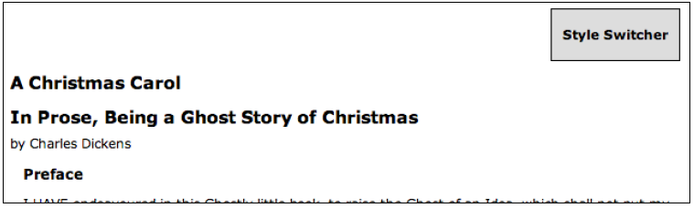
Simulating user interaction
Now when the page loads, the switcher is collapsed just as if it had been clicked, as shown in the following screenshot:
If we were hiding content that we wanted people without JavaScript enabled to see, this would be a reasonable way to implement graceful degradation. The .trigger() method provides the same set of shortcut methods that .on() does. When these shortcuts are used with no arguments, the behavior is to trigger the action rather than bind it:
$(document).ready(function() {
$('#switcher').click();
});
Listing 3.24

Slide 65
Reacting to keyboard events
As another example, we can add keyboard shortcuts to our style switcher. When the user types the first letter of one of the display styles, we will have the page behave as if the corresponding button was clicked. To implement this feature, we will need to explore keyboard events, which behave a bit differently from mouse events.
There are two types of keyboard events: those that react to the keyboard directly (keyup and keydown) and those that react to text input (keypress). A single character entry event could correspond to several keys, for example, when the Shift key in combination with the X key creates the capital letter X. While the specifics of implementation differ from one browser to the next (unsurprisingly), a safe rule of thumb is: if you want to know what key the user pushed, you should observe the keyup or keydown event; if you want to know what character ended up on the screen as a result, you should observe the keypress event. For this feature, we just want to know when the user presses the D, N, or L key, so we will use keyup.

Slide 66
Reacting to keyboard events
Next, we need to determine which element should watch for the event. This is a little less obvious than with mouse events, where we have a visible mouse cursor to tell us about the event's target. Instead, the target of a keyboard event is the element that currently has the keyboard focus. The element with focus can be changed in several ways, including using mouse clicks and pressing the Tab key. Not every element can get the focus, either; only items that have default keyboard-driven behaviors such as form fields, links, and elements with a .tabIndex property are candidates.
In this case, we don't really care what element has the focus; we want our switcher to work whenever the user presses one of the keys. Event bubbling will once again come in handy, as we can bind our keyup event to the document element and have assurance that eventually any key event will bubble up to us.

Slide 67
Reacting to keyboard events
Finally, we will need to know which key was pressed when our keyup handler gets triggered. We can inspect the event object for this. The .which property of the event contains an identifier for the key that was pressed, and for alphabetic keys, this identifier is the ASCII value of the uppercase letter. With this information, we can now create an object literal of letters and their corresponding buttons to click. When the user presses a key, we'll see if its identifier is in the map, and if so, trigger the click:
$(document).ready(function() {
var triggers = {
D: 'default',
N: 'narrow',
L: 'large'
};
$(document).keyup(function(event) {
var key = String.fromCharCode(event.which);
if (key in triggers) {
$('#switcher-' + triggers[key]).click(); }
});
});
Listing 3.25

Slide 68
Reacting to keyboard events
Presses of these three keys now simulate mouse clicks on the buttons—provided that the key event is not interrupted by features such as Firefox's search for text when I start typing.
As an alternative to using .trigger() to simulate this click, let's explore how to factor out code into a function so that more than one handler can call it in this case, both click and keyup handlers. While not necessary in this case, this technique can be useful in eliminating code redundancy:
$(document).ready(function() {
// Enable hover effect on the style switcher
$('#switcher').hover(function() {
$(this).addClass('hover');
}, function() {
$(this).removeClass('hover');
});
// Allow the style switcher to expand and collapse
var toggleSwitcher = function(event) {
if (!$(event.target).is('button')) {
$('#switcher button').toggleClass('hidden');
}
};
Continues →

Slide 69
Reacting to keyboard events
$('#switcher').on('click', toggleSwitcher);
// Simulate a click so we start in a collapsed state
$('#switcher').click();
// The setBodyClass() function changes the page style
// The style switcher state is also updated
var setBodyClass = function(className) {
$('body').removeClass().addClass(className);
$('#switcher button').removeClass('selected');
$('#switcher-' + className).addClass('selected');
$('#switcher').off('click', toggleSwitcher);
if (className == 'default') {
$('#switcher').on('click', toggleSwitcher);
}
};
// Begin with the switcher-default button "selected“
$('#switcher-default').addClass('selected');
// Map key codes to their corresponding buttons to click
var triggers = {
D: 'default',
N: 'narrow',
L: 'large’ };
// Call setBodyClass() when a button is clicked
$('#switcher').click(function(event) {
if ($(event.target).is('button')) {
var bodyClass = event.target.id.split('-')[1];
setBodyClass(bodyClass); }
});
// Call setBodyClass() when a key is pressed
$(document).keyup(function(event) {
var key = String.fromCharCode(event.keyCode);
if (key in triggers) {
setBodyClass(triggers[key]); }
});
});
Listing 3.26

Slide 70
Reacting to keyboard events
This final revision consolidates all the previous code examples of this chapter. We have moved the entire block of code into a single $(document).ready() handler and made our code less redundant.

Slide 71
Summary
The abilities we've discussed in this chapter allow us to react to various user-driven and browser-initiated events. We have learned how to safely perform actions when the page loads, how to handle mouse events such as clicking on links or hovering over buttons, and how to interpret keystrokes.
In addition, we have delved into some of the inner workings of the event system, and can use this knowledge to perform event delegation and to change the default behavior of an event. We can even simulate the effects of an event as if the user initiated it.
We can use these capabilities to build quite interactive pages. In the next chapter, we'll learn how to provide visual feedback to the user during these interactions.

